Slide 1
CHAPTER 3
Software Design with UML
Dhara Sharma Dept. of Computer Engineering LJ Polytechnic

Slide 2
Software Design with UML
Design Process
The purpose of the design process is to plan a solution of problems specified in SRS.
Design process includes user interface design, input output design, data design, process and program design and technical specification etc.
It transforming the customer requirements (described in SRS) into appropriate form that is suitable to implement using any of programming languages.
Output of design process is design documents.
Dhara Sharma Dept. of Computer Engineering LJ Polytechnic

Slide 3
Software Design with UML
Design Activities
Design Activities
Architectural design
Interface design
Component design
Database design
Dhara Sharma Dept. of Computer Engineering LJ Polytechnic

Slide 4
Software Design with UML
Design Methodologies
Design methodologies are followed in software development from beginning up to the completion of the product.
Design methodologies use to provide guidelines for the design activity.
There are two design methodologies:
Function Oriented Design
Object Oriented Design
Dhara Sharma Dept. of Computer Engineering LJ Polytechnic

Slide 5
Software Design with UML
Data Modeling
Analysis model often begin with data modeling.
Data model consists of three interrelated pieces of information:
The data object,
The attributes that describe the data object, and
The relationships that connect data objects to one another.
Dhara Sharma Dept. of Computer Engineering LJ Polytechnic

Slide 6
Software Design with UML
Data Object
A data object is a representation of almost any composite information that must be understood by software.
composite information - number of different properties or attributes.
A data object can be:-
An external entity (e.g., anything that produces or consumes information),
A thing (e.g., a report or a display),
An occurrence (e.g., a telephone call)
Event (e.g., an alarm),
A role (e.g., salesperson),
An organizational unit (e.g., accounting department),
A place (e.g., a warehouse),
A structure (e.g., a file).
Dhara Sharma Dept. of Computer Engineering LJ Polytechnic

Slide 7
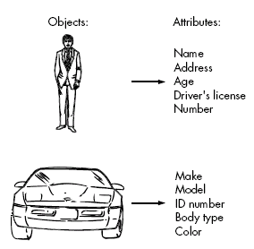
Software Design with UML
Data Object
For Ex.- Set of attributes can be defined for a person or a car (i.e. Data Object)
Dhara Sharma Dept. of Computer Engineering LJ Polytechnic

Slide 8
Software Design with UML
Data Attributes
Define the properties of a data object.
Attributes name a data object, describe its characteristics, and in some cases, make reference to another object.
In addition, one or more of the attributes must be defined as an identifier( Key value or Unique value).
Ex. Data object Car has Id number as identifier.
Dhara Sharma Dept. of Computer Engineering LJ Polytechnic

Slide 9
Software Design with UML
Relationships
Data objects are connected to one another in different ways. Consider two data objects:
Book
Bookstore
A connection is established between book and bookstore because the two objects are related
Dhara Sharma Dept. of Computer Engineering LJ Polytechnic

Slide 10
Software Design with UML
Relationships
To determine relationship between them, must understand the role of book and bookstore.
Can define a set of object/relationship pairs that define the relevant relationships.
For Example:
A bookstore orders books.
A bookstore displays books.
A bookstore stocks books.
A bookstore sells books.
A bookstore returns books.
Dhara Sharma Dept. of Computer Engineering LJ Polytechnic

Slide 11
Software Design with UML
Cardinality and Modality
Additional element of data modeling.
Object X relates to object Y does not provide enough information.
How many occurrences of object X are related to how many occurrences of object Y called cardinality.
Dhara Sharma Dept. of Computer Engineering LJ Polytechnic

Slide 12
Software Design with UML
Cardinality
Representing the number of occurrences objects in a given relationship.
Cardinality is the specification of the number of occurrences of one [object] that can be related to the number of occurrences of another.
Cardinality is usually expressed as simply 'one' or 'many’.
1:1 – One object can relate to only one other object.
1:M – one object can relate to many objects.
M:N – Some no. of occurrences of an object can relate to some other no. of occurrences of another object.
Dhara Sharma Dept. of Computer Engineering LJ Polytechnic

Slide 13
Software Design with UML
Modality
Cardinality does not provide an indication of whether or not a particular data object must participate in the relationship.
Modality of a relationship is 0 if there is no explicit need for the relationship to occur or the relationship is optional.
The modality is 1 if an occurrences of the relationship is mandatory.
Dhara Sharma Dept. of Computer Engineering LJ Polytechnic

Slide 14
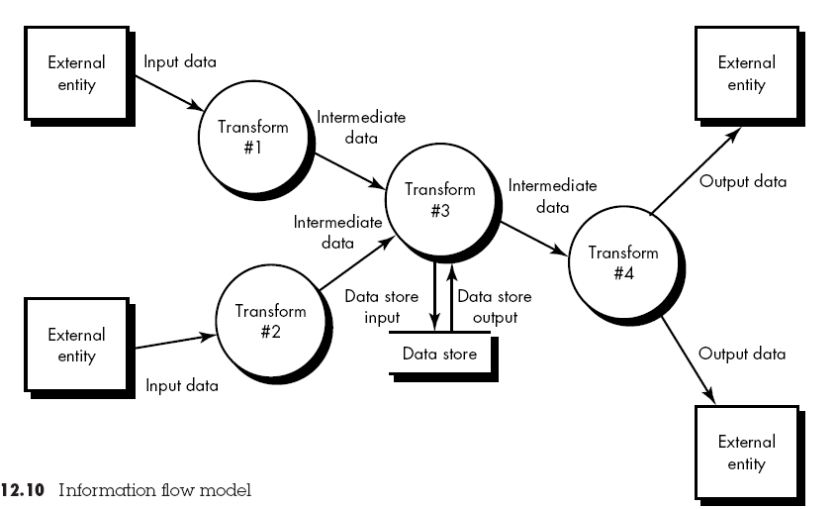
Software Design with UML
Information Flow Diagram
Dhara Sharma Dept. of Computer Engineering LJ Polytechnic

Slide 15
Software Design with UML
Creating Data Flow Model
It enables software engineer to develop models of the information domain and functional domain at the same time.
Data flow diagram may be used to represent a system or software at any level of abstraction
As DFD is refined into greater levels of detail, the analyst performs an implicit functional decomposition of the system.
As DFD refinement results in corresponding refinement of data as it moves through the processes that represent the application
Dhara Sharma Dept. of Computer Engineering LJ Polytechnic

Slide 16
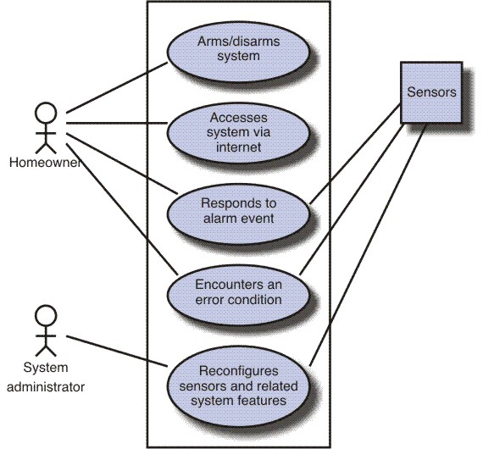
Software Design with UML
Scenario Based Diagram
Dhara Sharma Dept. of Computer Engineering LJ Polytechnic

Slide 17
Software Design with UML
End
Of
Chapter
Dhara Sharma Dept. of Computer Engineering LJ Polytechnic

